Slide 1
Public Health Collaborations to
Improve Health Outcomes:
Healthy Aging Opportunities
Lynda Anderson, PhD
Director, Healthy Aging Program
Centers for Disease Control & Prevention
National Association of Deans and Directors School of Social Work Conference
October 26, 2011

Slide 2
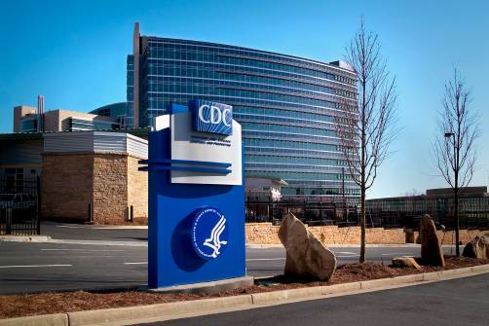
Centers for Disease Control and Prevention
Prevention is overarching goal
Science drives what we do
Focus where we know we can make a difference

Slide 3
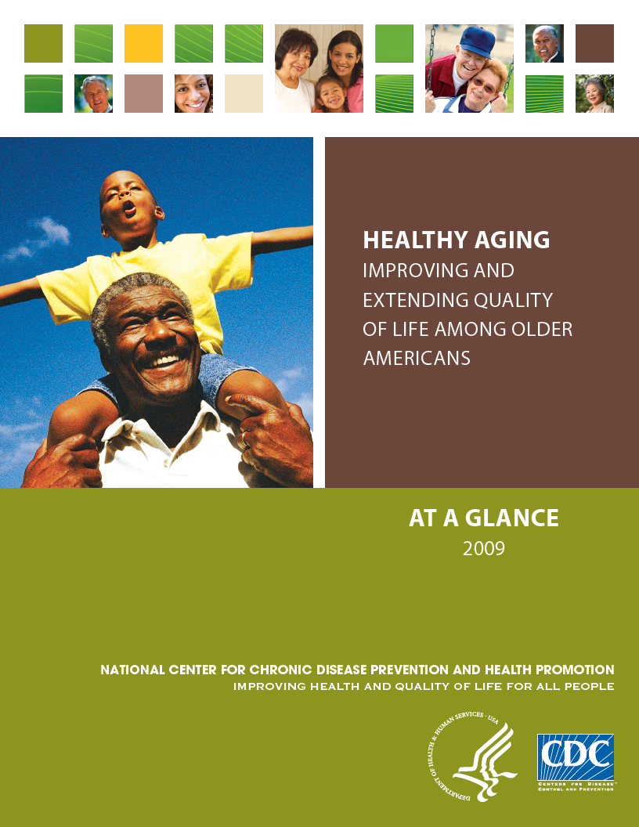
Healthy Aging: The Role of CDC
Provide quality health information
Monitor health status of older Americans
Identify and put into practice what works
Integrate public health prevention expertise with the reach of the aging service network
Facilitate prevention efforts of health care providers and others who serve older adults

Slide 4
Behavioral Risk Factor Surveillance System
(BRFSS)
The world’s largest, on-going telephone health survey system, tracking health conditions and risk behaviors in the United States yearly since 1984
Collects information from adults aged 18 years and older
Conducted by health departments in all states, the District of Columbia, Puerto Rico, the Virgin Islands, and Guam

Slide 5
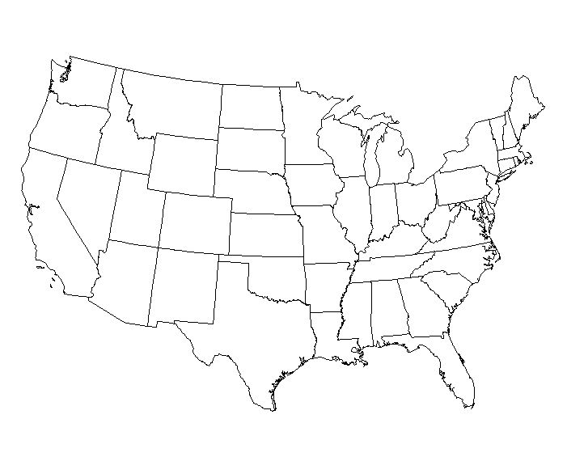

Applications of BRFSS
Identify health problems
Establish and track health objectives
Support health policies and legislation
Develop and evaluate public health programs
www.cdc.gov/brfss

Slide 6
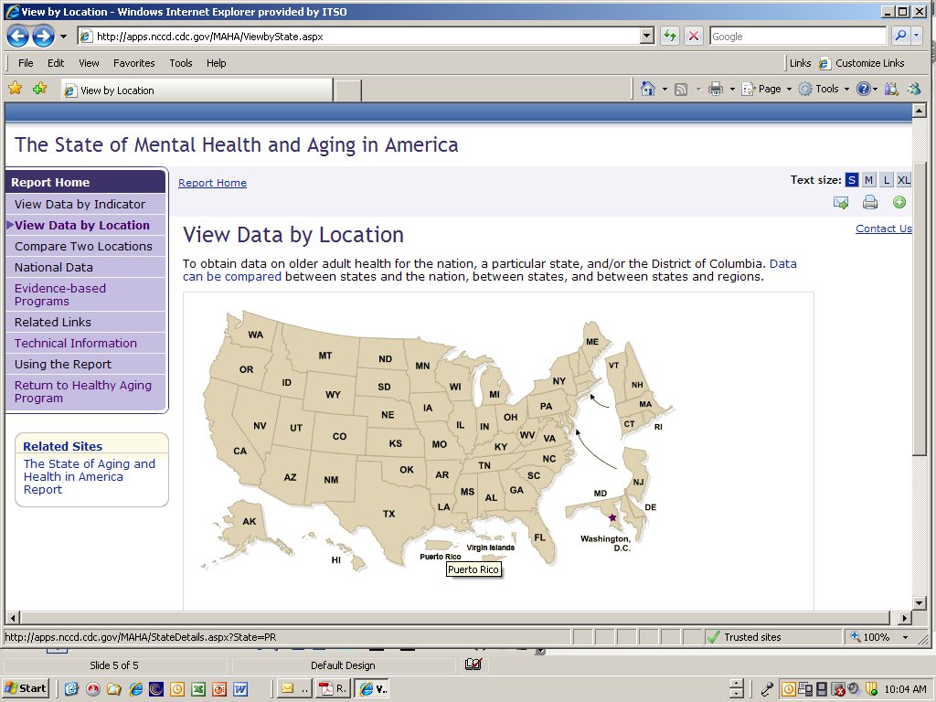
Interactive Versions of Data Reports

Slide 7
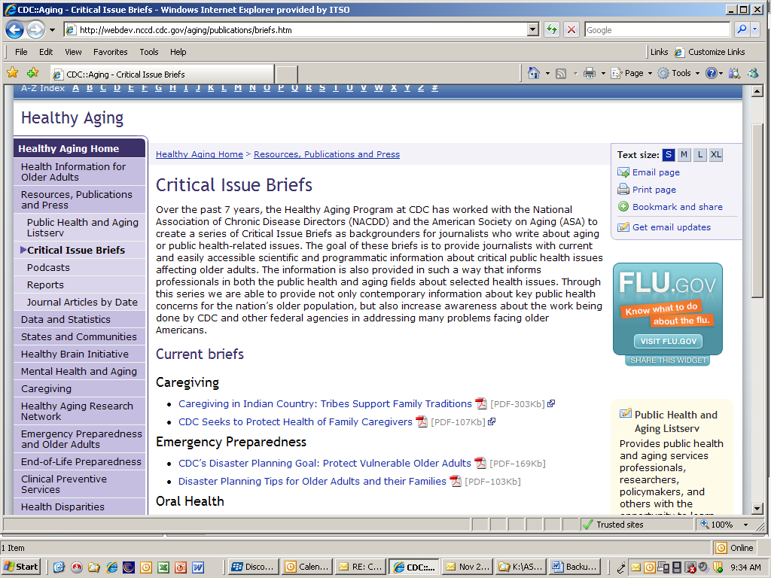
Dissemination of Information and Tools

Slide 8

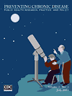
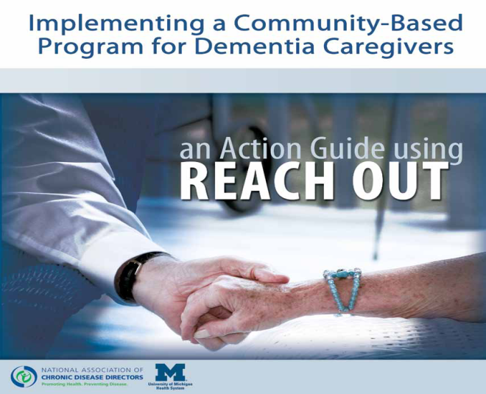
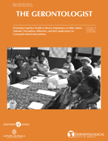
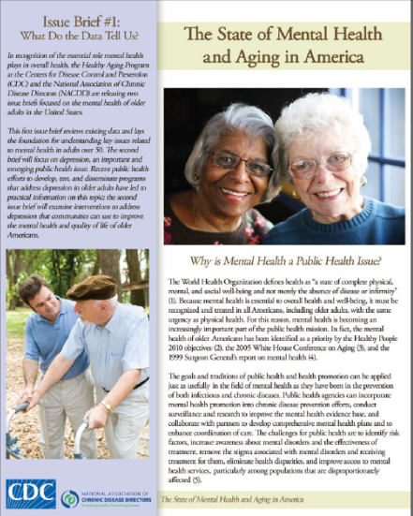
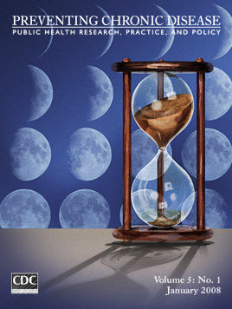

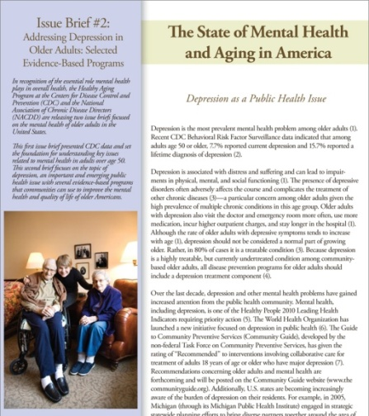
Examples of Materials from Healthy Aging Program

Slide 9
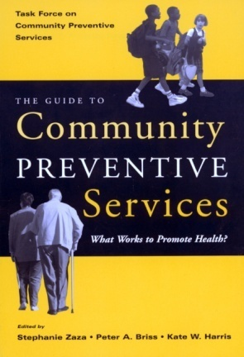

Translating Research to Practice
The Guide to Community Preventive Services
  Provides information about high-priority
  interventions
  Older Adults:
    Interventions to treat depression
  www.thecommunityguide.org
  Prevention Research Centers
Extramural program
Established by Congress in 1984
www.cdc.gov/prc

Slide 10

Overview
Research centers at accredited Schools of Public Health or Medicine with Preventive Medicine Residency
Cooperative agreements in 5-year funding cycles
Research conducted with underserved communities
Fund 37 PRCs in 27 states (2010-2014)
300+ active projects

Slide 11
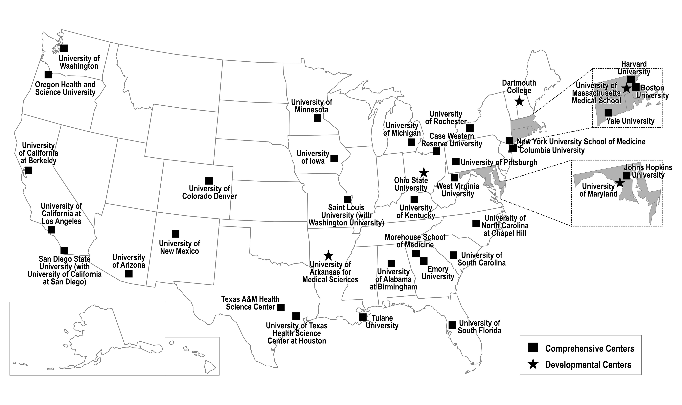
PRC Locations
2010-2014

Slide 12
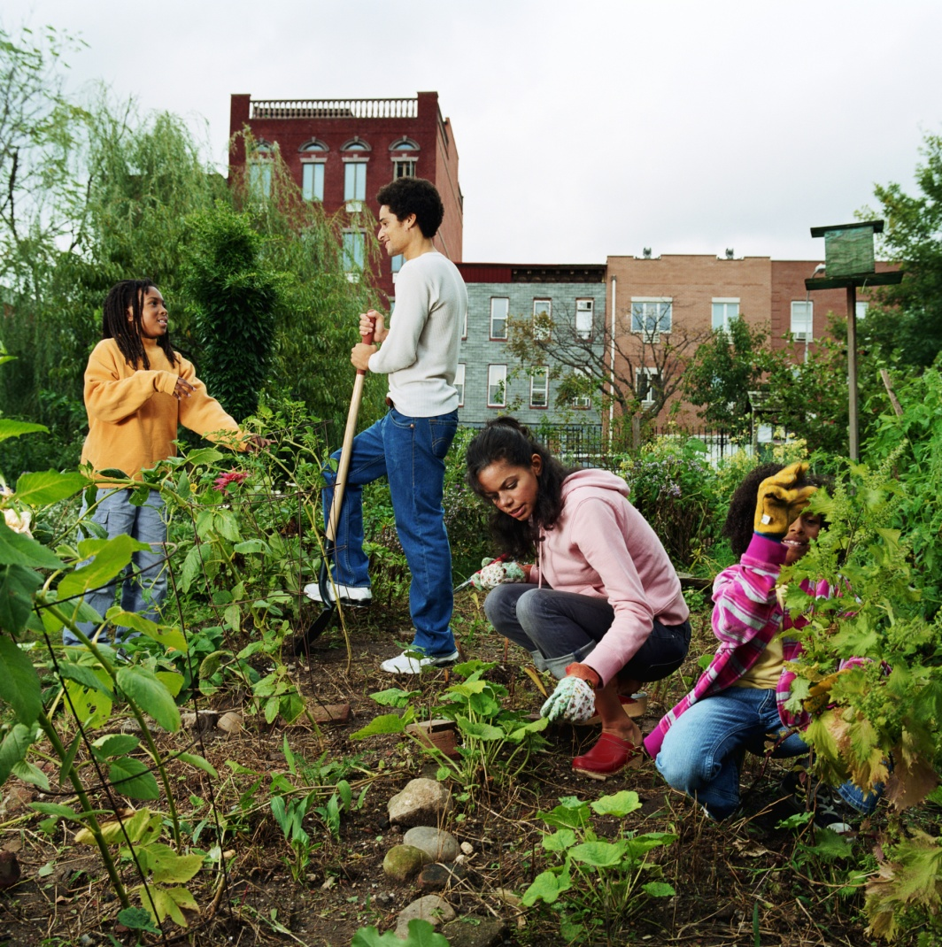
Working with a PRC Provides Opportunities
Access to large, diverse populations
Long-term relationships with communities
Strong connections with public health practice systems
Multidisciplinary research approaches
Policy development and analysis

Slide 13

PRCs’ Expertise
Research to develop effective interventions and policies
Technical assistance for
  Implementation
  Dissemination
  Evaluation
Scientific publications
Community engagement
  National Community Committee

Slide 14

PRC Special Interest Projects
Established in 1993 to
  Support research in health promotion and disease prevention
    Focus on the major causes of death and disability
    Improve public health practice within communities
    Cultivate effective state and local public health programs
Eligible sponsors
  CDC Centers/Institutes/Offices
  Other federal agencies, such as National Institutes of Health

Slide 15
Prevention Research Centers Program
Thematic Networks
  CDC's Healthy Aging Research Network
  CDC’s Healthy Aging Program
  Better understand the determinants of healthy aging in older adults
  Identify interventions that promote healthy aging
  Assist in the translation of research into sustainable
  community-based programs throughout the nation
Notes:
15

Slide 16
Member Organizations
CDC Healthy Aging Program (funder)
CDC Division of Nutrition, Physical Activity and Obesity
CDC/PRC National Community Committee
AARP
Administration on Aging
Environmental Protection Agency
National Association of Chronic Disease Directors
National Council on Aging

Slide 17
Competencies of HAN
Advance science toward action and policy
Improve capacity & infrastructure for healthy aging
Develop and test evaluation tools
Conduct multi-site studies
Access/engage experts across disciplines
Leverage connections with partners
Notes:
17

Slide 18
CDC-HAN Resources www.prc-han.org
Web-based training programs on evidence-based health promotion programs and RE-AIM
Conference materials including speaker handouts, monographs
Webinars and Action Briefs
Scholarly publications

Slide 19

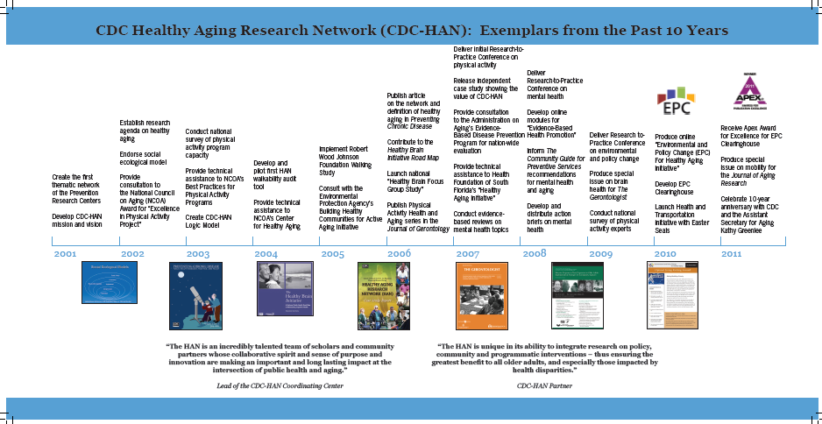

Slide 20
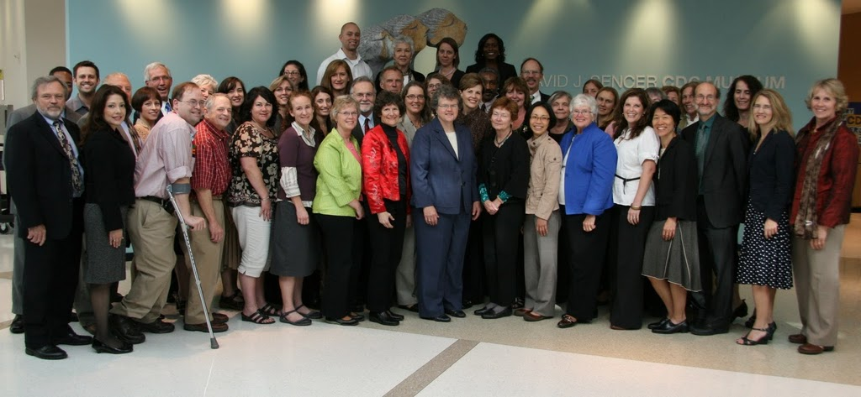
CDC-HAN September 2011 Meeting

Slide 21
Contact Information
CDC’s Healthy Aging Program
Lynda Anderson, PhD
Director, Healthy Aging Program
laa0@cdc.gov
Jessica Gill, MPH
Public Health Advisor, Healthy Aging Program
ftm4@cdc.gov
The findings and conclusions in this presentation are those of the author and do not necessarily represent the official position of CDC or ATSDR
Notes:
21

